Slide 1
ORGANIZED INDUSTRIAL ZONE AND FREE ZONE INTRODUCTION
19.03.2013

Slide 2
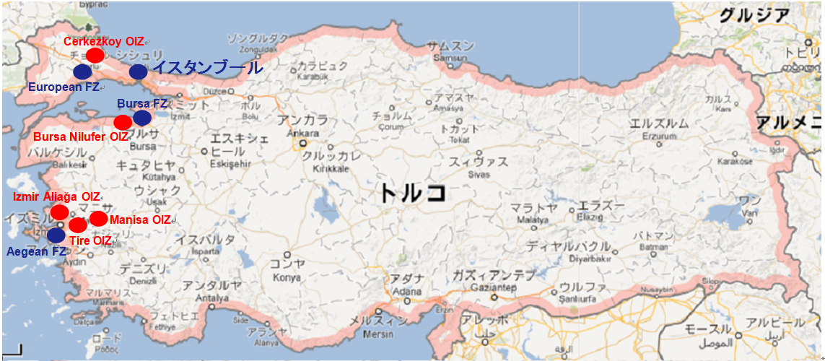
Map of OIZ and FZ

Slide 3
OIZ Concept
Organized Industrial Zones (OIZs) are designed to allow companies to operate within an investor-friendly environment with ready-to-use infrastructure and social facilities
The existing infrastructure provided in the zones includes roads, water, natural gas, electricity, communications, waste treatment, and other services.
There are 263 OIZs in 80 provinces, 148 of which are currently operational, while the remaining 115 OIZs are being constructed throughout Turkey.

Slide 4
Advantages of OIZs
In addition to the investment incentives scheme in Turkey (general investment incentives, incentives for large-scale investments, region and sector-based incentives, employment incentives, R&D supports, etc.), investors operating in the OIZs can benefit from the following advantages:
No VAT for land acquisitions
Exemption from real estate duty for five years starting after the construction of the plant
Low water, natural gas, and telecommunication costs
For unification and/or separation of plots, no tax to be paid (which is about 0.54% of the total cost)
Exemption from municipality tax for construction and usage of the plant
Exemption from the municipality tax on solid waste if the OIZ does not benefit from the municipality service

Slide 5
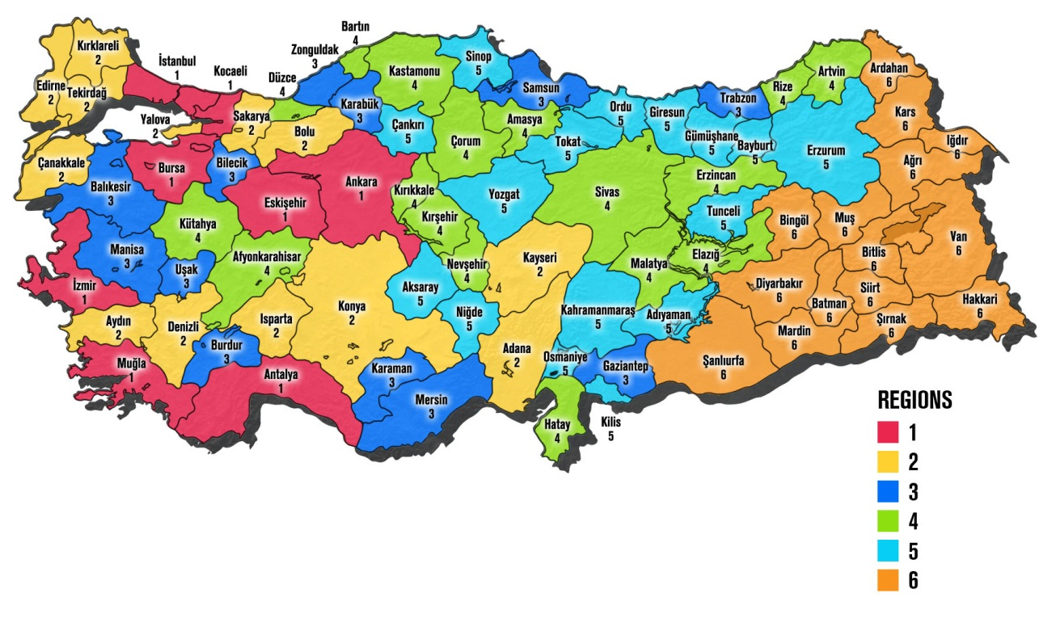
Incentive Regions in Turkey

Slide 6
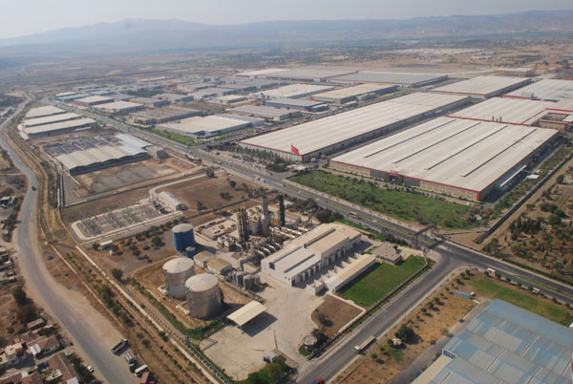
Manisa Organized Industrial Zone
Total Area : 959 Hectare
Establishment Year : 1970 Employment : 37.500
Company number : 212

Slide 7
DETAILED LAND RESEARCH
CATEGORY | CRITERIA | FORMAT | MANİSA OIZ
GENERAL | City |  | MANİSA
 | Name of OIZ/FZ |  | MOSB
 | Address |  | Manisa Organize Sanayi Bölgesi Kurtuluş Cd. No:2 45030 MANİSA
 | Phone Number |  | +90236233 18 16
 | Fax Number |  | +90236233 25 47
 | Website |  | www.mosb.org.tr
LOGISTICS | Nearest Highway | Name/Distance(km) | 1 km
 | Nearest Port | Name/Distance(km) | Alsancak: 45 km
 | Nearest Railway Station | Name/Distance(km) | Manisa: 5km
 | Nearest Airport | Name/Distance(km) | Adnan Menderes: 60 km
 | Nearest Custom | Name/Distance(km) | Within the zone
 | Nearest City Centre | Name/Distance(km) | Manisa : 5 km İzmir: 35 km
LAND | Total Area | sqm | 9,590,000
 | Land Availability | sqm | 899,914
 | Allocation Type | Rent/Purchase | Purchase
 | Rental Cost | USD/sqm | NA
 | Purchase Cost | TL,USD,EUR/sqm | 150 TL-200 TL
UTILITY COSTS | Electricity |  | 0,185500 TL/kWh(includes VAT)
 | Natural Gas |  | 0,740214 TL/Sm³
 | Water |  | 0,52 TL/m³ +VAT
 | Waste Water Treatment |  | 0,416 TL/m³/month
Last Updated 29.03.2013

Slide 8
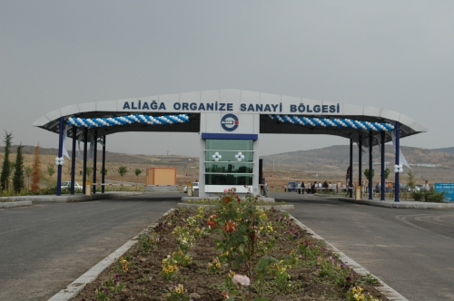
İzmir Aliağa Organized Industrial Zone
Total Area : 922 Hectare
Establishment Year : 1997 Employment : 17.000
Company number : 40

Slide 9
DETAILED LAND RESEARCH
CATEGORY | CRITERIA | FORMAT | İZMİR ALİAĞA OIZ
GENERAL | City |  | İZMİR
 | Name of OIZ/FZ |  | ALOSBİ
 | Address |  | İzmir Çanakkale E 87 Karayolu 67.km
 | Phone Number |  | +90232 6215050
 | Fax Number |  | +90232 6215060
 | Website |  | www.alosbi.org.tr/
LOGISTICS | Nearest Highway | Name/Distance(km) | İzmir Çanakkale Highway
 | Nearest Port | Name/Distance(km) | İzmir Port: 65 km
 | Nearest Railway Station | Name/Distance(km) | Biçerova: 12 km
 | Nearest Airport | Name/Distance(km) | Adnan Menderes: 80 km
 | Nearest Custom | Name/Distance(km) | Biçerova: 12 km
 | Nearest City Centre | Name/Distance(km) | İzmir 65 km
LAND | Total Area | sqm | 9,220,000
 | Land Availability | sqm | 2,718,087
 | Allocation Type | Rent/Purchase | Purchase
 | Rental Cost | USD/sqm | NA
 | Purchase Cost | TL,USD,EUR/sqm | 53 EUR-70 EUR
UTILITY COSTS | Electricity |  | 0,188906 TL/kwh+VAT+tax
 | Natural Gas |  | 0,714194 TL/Sm³
 | Water |  | 1.25 TL/m³+VAT
 | Waste Water Treatment |  | 0.7 TL/m³+KDV
Last Updated 29.03.2013

Slide 10
TİRE OIZ
DETAILED LAND RESEARCH
CATEGORY | CRITERIA | FORMAT | TİRE OIZ
GENERAL | City |  | İZMİR
 | Name of OIZ/FZ |  | TOSBI
 | Address |  | Turan Mah. Taştepe Mevkii Tire - İzmir
 | Phone Number |  | +90(232) 5135010
 | Fax Number |  | +90(232) 5135011
 | Website |  | www.tosbi.org.tr
LOGISTICS | Nearest Highway | Name/Distance(km) | 28 km İzmir Aydın HW
 | Nearest Port | Name/Distance(km) | Alsancak Port: 75km
 | Nearest Railway Station | Name/Distance(km) | Will be available inside OIZ in July 2013
 | Nearest Airport | Name/Distance(km) | Adnan Menderes Airport: 50 km
 | Nearest Custom | Name/Distance(km) | Will be available inside OIZ in July 2013
 | Nearest City Centre | Name/Distance(km) | Tire: 4km İzmir: 75km
LAND | Total Area | sqm | 4,063,093
 | Land Availability | sqm | 941.0000
 | Allocation Type | Rent/Purchase | Purchase
 | Rental Cost | USD/sqm | NA
 | Purchase Cost | TL,USD,EUR/sqm | 35 EUR
UTILITY COSTS | Electricity |  | 0,1705 TL/kWh +VAT + Tax
 | Natural Gas |  | 0,07 TL/Kwh + VAT
 | Water |  | 1,60 TL/m³ +VAT
 | Waste Water Treatment |  | According to pollution parameter
As of 15.04.2013 1 USD= 1.7915 TL and 1 EUR=2.3403 TL

Slide 11
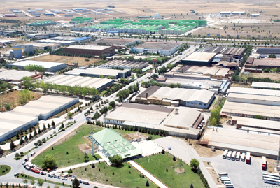
Çerkezköy Organized Industrial Zone
Total Area : 1234 Hectare
Establishment Year : 1976 Employment : 55.000
Company number : 250

Slide 12
DETAILED LAND RESEARCH
CATEGORY | CRITERIA | FORMAT | ÇERKEZKOY OIZ
GENERAL | City |  | TEKİRDAĞ
 | Name of OIZ/FZ |  | ÇOSB
 | Address |  | Atatürk Cad. No:4 59501 Çerkezköy/Tekirdağ
 | Phone Number |  | +90282 758 11 56
 | Fax Number |  | +90282 758 11 60
 | Website |  | www.cosb.org.tr
LOGISTICS | Nearest Highway | Name/Distance(km) | 15 km TEM
 | Nearest Port | Name/Distance(km) | Eregli Port: 60 km ekirdag Port: 75 km
 | Nearest Railway Station | Name/Distance(km) | Çerkezkoy: 5 km
 | Nearest Airport | Name/Distance(km) | Çorlu Airport: 50 km Ataturk Int. Airport: 90 km
 | Nearest Custom | Name/Distance(km) | Cerkezkoy: 5 km
 | Nearest City Centre | Name/Distance(km) | Cerkezkoy: 5 km
LAND | Total Area | sqm | 12,340,000
 | Land Availability | sqm | 45,000
 | Allocation Type | Rent/Purchase | Purchase
 | Rental Cost | USD/sqm | NA
 | Purchase Cost | TL,USD,EUR/sqm | 110 USD
UTILITY COSTS | Electricity |  | 0,17770 TL/kwh+VAT+tax
 | Natural Gas |  | 0,717783 TL/Sm³+VAT
 | Water |  | 0,474 TL/m³+VAT
 | Waste Water Treatment |  | 0,632 TL/m³+VAT
Last Updated 29.03.2013

Slide 13
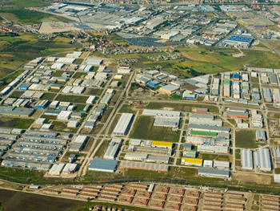
Bursa Nilüfer Organized Industrial Zone
Total Area : 234 Hectare
Establishment Year : 2001 Employment : 17.000
Company number : 264

Slide 14
DETAILED LAND RESEARCH
CATEGORY | CRITERIA | FORMAT | BURSA NİLÜFER OSB
GENERAL | City |  | BURSA
 | Name of OIZ/FZ |  | NOSAB
 | Address |  | NOSAB Atatürk Bulvarı No. 2 16140 Nilüfer/BURSA
 | Phone Number |  | +90224 411 09 00
 | Fax Number |  | +90.224 411 09 08
 | Website |  | www.nosab.org.tr
LOGISTICS | Nearest Highway | Name/Distance(km) | E-90: 10 km
 | Nearest Port | Name/Distance(km) | Gemlik Port: 40 km Bandırma Port: 110 km
 | Nearest Railway Station | Name/Distance(km) | Bozüyük: 125 km
 | Nearest Airport | Name/Distance(km) | Yenişehir Airprot:70 km Sabiha Gökçen Airpor: 200 km İstanbul Atatürk Airport: 280 km
 | Nearest Custom | Name/Distance(km) | Gemlik: 3 km
 | Nearest City Centre | Name/Distance(km) | Bursa: 15 km
LAND | Total Area | sqm | 2,340,000
 | Land Availability | sqm | 170,000
 | Allocation Type | Rent/Purchase
 | Rental Cost | USD/sqm
 | Purchase Cost | TL,USD,EUR/sqm | 450 TL-600 TL
UTILITY COSTS | Electricity |  | 0,20278 TL/kwh+VAT+tax
 | Natural Gas |  | 0,7594021 TL/Sm³
 | Water |  | 4,52 TL/m³+VAT
 | Waste Water Treatment |  | 5,000 TL/m³+VAT
Last Updated 29.03.2013

Slide 15
Free Zone Concept
Free zones are defined as special sites within the country but deemed to be outside of the customs borders and they are the regions where the valid regulations to foreing trade and other financial and economic laws are not applicable.
Free zones are also the regions where more convenient business climate is offered in order to increase trade volume and export for industrial and commercial activities as compared to the other parts of country.
There are 19 Free Zones in Turkey.
Free Zone Types
Semi-Private Free Zones
In these free zones, the land is owned by state and operator company can rent places and operate the zone.
Private Free Zones
In these free zones, the land is owned by the operator company and along with the operation of the zone, operator company can sell places to it’s investors.

Slide 16
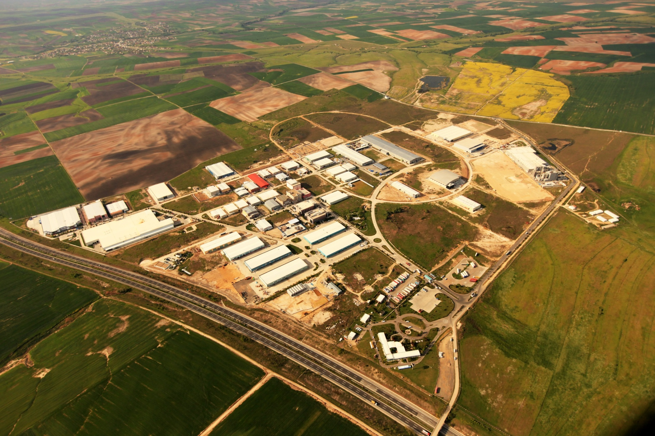
European Free Zone
Total Area : 2,000,000 m²
Establishment Year : 1999 Employment : 2800
Company number : 150
Trade Volume : 2,1 Billion $

Slide 17
DETAILED LAND RESEARCH
CATEGORY | CRITERIA | FORMAT | EUROPEAN FREE ZONE
GENERAL | City |  | TEKİRDAĞ
 | Name of OIZ/FZ |  | ASB
 | Address |  | Velimese Mevkii Corlu/Tekirdag
 | Phone Number |  | +90 282 691 10 10 '+90 212 484 20 00
 | Fax Number |  | 90 212 484 20 58
 | Website |  | www.asb.com.tr
LOGISTICS | Nearest Highway | Name/Distance(km) | E-80: 8 km
 | Nearest Port | Name/Distance(km) | Akport: 45 km
 | Nearest Railway Station | Name/Distance(km) | Velimese Station: 8 km Cerkezkoy Station: 15 km
 | Nearest Airport | Name/Distance(km) | Corlu Airport: 15 km
 | Nearest Custom | Name/Distance(km) | Within the zone
 | Nearest City Centre | Name/Distance(km) | Tekirdag: 15 km
LAND | Total Area | sqm | 2,000,000
 | Land Availability | sqm | 193,810
 | Allocation Type | Rent/Purchase | Purchase
 | Rental Cost | USD/sqm | -
 | Purchase Cost | TL,USD,EUR/sqm | 110 USD
UTILITY COSTS | Electricity |  | 0,234TL/kwh +VAT+tax
 | Natural Gas |  | 0,714TL/Sm3 + 0,023TL/Sm3 + %10
 | Water |  | 1,25 USD/m³ includes waste water
 | Waste Water Treatment |  | No fee
Last Updated 29.03.2013

Slide 18
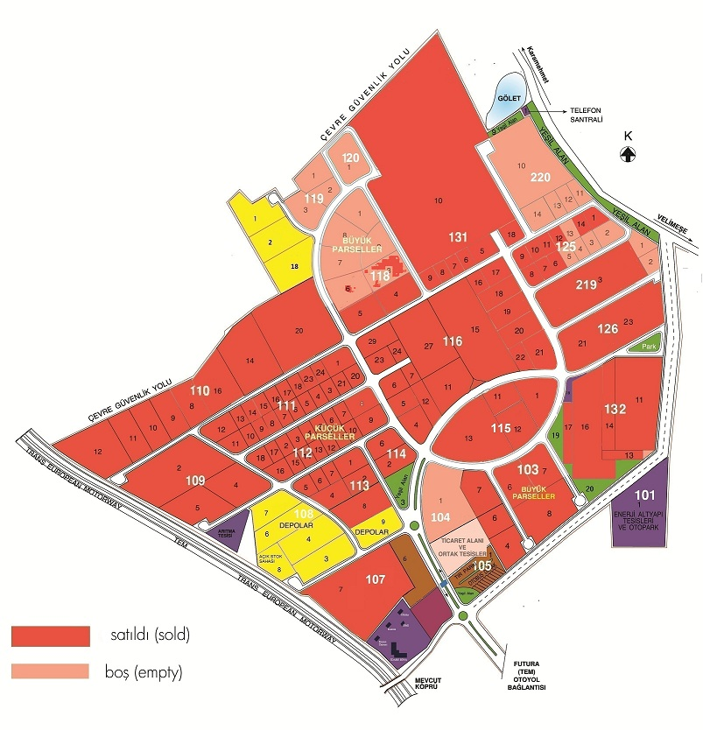
Eurpoean Free Zone Services
Ready infrastructure
Full ownership
No tax for title deed transfer

Slide 19
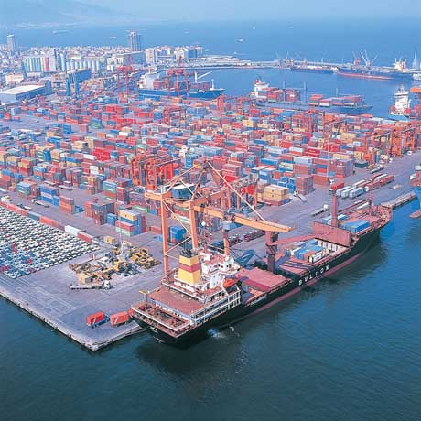
Aegean Free Zone
Total Area : 220 Hectare
Establishment Year : 1990 Employment : 20,400
Company number : 225
Trade Volume 2012 : 4,7 Billion $

Slide 20
DETAILED LAND RESEARCH
CATEGORY | CRITERIA | FORMAT | AEGEAN FREE ZONE
GENERAL | City |  | İZMİR
 | Name of OIZ/FZ |  | ESBAŞ
 | Address |  | Ege Serbest Bölgesi, 35410 Gaziemir
 | Phone Number |  | +90 232 2513851
 | Fax Number |  | +90 232 2514807
 | Website |  | www.esbas.com.tr
LOGISTICS | Nearest Highway | Name/Distance(km) | 0 km
 | Nearest Port | Name/Distance(km) | İzmir Port 12 km. (via 4 lane freeway)
 | Nearest Railway Station | Name/Distance(km) | Alsancak : 12 km
 | Nearest Airport | Name/Distance(km) | Adnan Menderes International Airport: 4 km
 | Nearest Custom | Name/Distance(km) | Within the zone
 | Nearest City Centre | Name/Distance(km) | izmir:1 km
LAND | Total Area | sqm | 2,200,000
 | Land Availability | sqm | 600,000 expansion land will be available
 | Allocation Type | Rent/Purchase | Rent
 | Rental Cost | USD/sqm | 3.67 USD /m² / year
 | Purchase Cost | TL,USD,EUR/sqm | NA
UTILITY COSTS | Electricity |  | 0,137 USD/kwh +VAT+tax
 | Natural Gas |  | 0,0426 USD/kwh
 | Water |  | 3,00 USD/ m³
 | Waste Water Treatment |  | No fee
Last Updated 29.03.2013

Slide 21
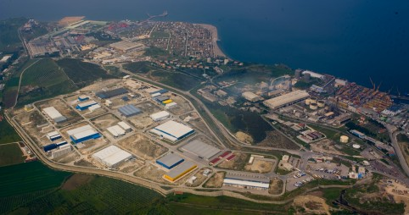
Bursa Free Zone
Total Area : 825,000 m²
Establishment Year : 1998 Employment : 8013
Company number : 132
Trade Volume : 1,571,579 $

Slide 22
DETAILED LAND RESEARCH
CATEGORY | CRITERIA | FORMAT | BURSA FREE ZONE
GENERAL | City |  | BURSA
 | Name of OIZ/FZ |  | BUSEB
 | Address |  | Hisar mevkii Liman yolu Gemlik/BURSA
 | Phone Number |  | +90 224 524 86 89
 | Fax Number |  | +90 224 524 86 87
 | Website |  | www.buseb.com
LOGISTICS | Nearest Highway | Name/Distance(km) | 3 km to Istanbul Highway
 | Nearest Port | Name/Distance(km) | 4 ports in 2 km area; GEMPORT,BOURSAN, RODA PORT, YILFERT PORT
 | Nearest Railway Station | Name/Distance(km) | No
 | Nearest Airport | Name/Distance(km) | Yenisehir Airport , Sabiha Gokcen International Airport, Ataturk International Airport,
 | Nearest Custom | Name/Distance(km) | Within the zone
 | Nearest City Centre | Name/Distance(km) | Bursa: 28 km Gemlik: 3 km
LAND | Total Area | sqm | 825,000
 | Land Availability | sqm | 65,000
 | Allocation Type | Rent/Purchase | Purchase
 | Rental Cost | USD/sqm | _
 | Purchase Cost | TL,USD,EUR/sqm | 250 USD
UTILITY COSTS | Electricity |  | 0,137480 USD/kwh+VAT+tax
 | Natural Gas |  | 0,042220 USD/kwh
 | Water |  | 1,75 USD / m³
 | Waste Water Treatment |  | No Fee
Last Updated 29.03.2013

Slide 23
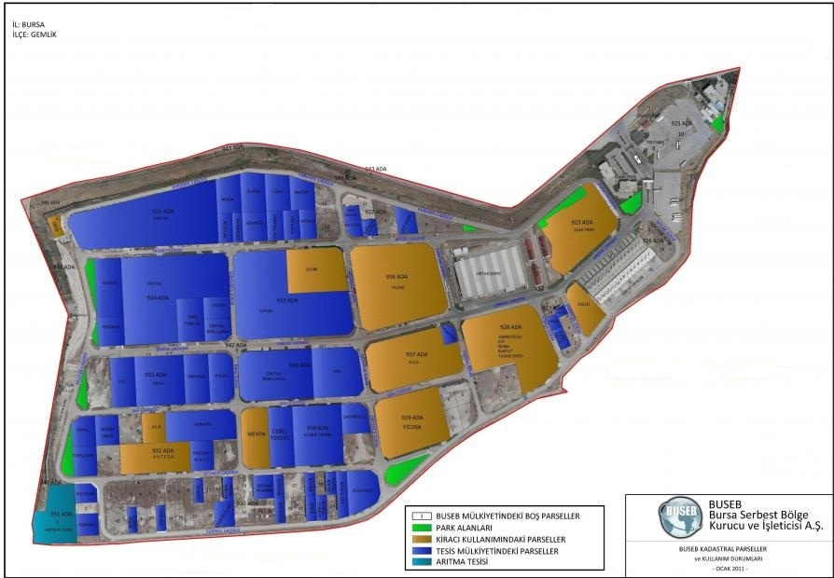
Bursa Free Zone Services
Ready infrastructure
Full ownership
No tax for title deed transfer

